Slide 1
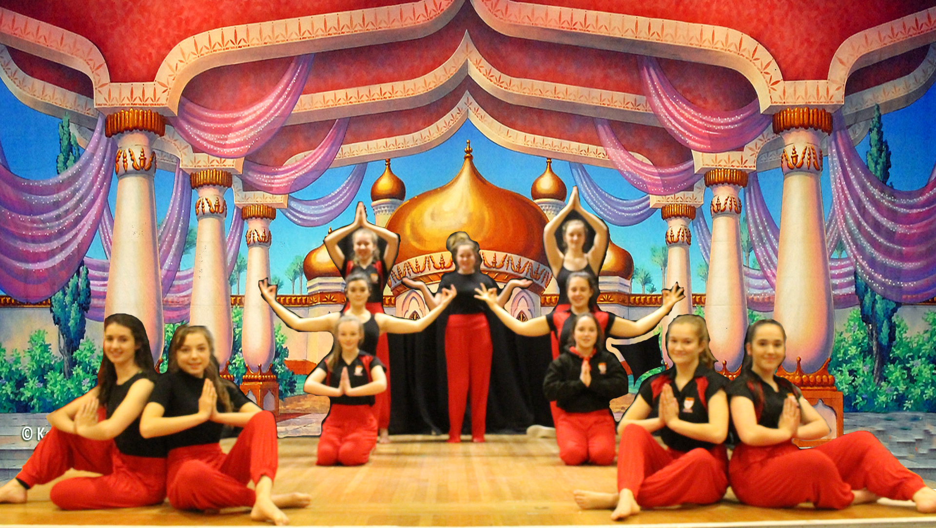
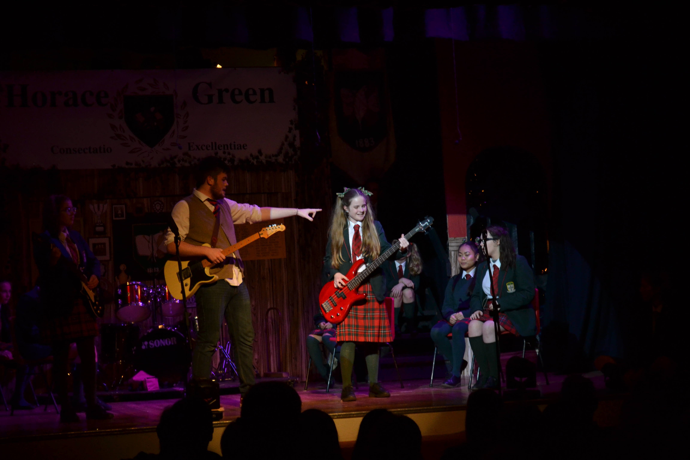
Welcome to the Drama Department
TO INSPIRE AND BE INSPIRED
RESPECT - LOVE - FAITH - TRUTH - EXCELLENCE

Slide 2
Meet your teacher.. Adam Tranmer
Having trained in Liverpool John Moores University I went onto work with a variety of Performing Arts before establishing Indigo Theatre Company in 1995. This gave me the opportunity to develop a variety of incredible performance projects and work with a host of talented people.
I am very aware of the importance of the Expressive Arts; they provide a cultural identity, social skills, self-confidence, and can act as an expressive outlet for our thoughts and feelings. The Expressive Arts allow a space for us to imagine a world that is changing at an incredible pace and the imagination and creativity of our young people will help us to make that progressive journey with integrity and depth of thought.
TO INSPIRE AND BE INSPIRED
RESPECT - LOVE - FAITH - TRUTH - EXCELLENCE

Slide 3
Who should study Drama at A level?
To study Drama at A Level, a grounding of GCSE Drama is recommended but not essential.
The study of Drama and Theatre at A Level can help students with a variety of skills as well as develop their creative career aspirations. Students who study this course will enhance their skills in creative thinking, teamwork, analysis, presentation skills, planning and of course performing.
A level Drama and Theatre tests your practical and theoretical understanding of theatre, as you explore a wide range of play texts throughout the two-year course. Practical lessons focus on performance work – getting on your feet and creating real theatre. In theory lessons, you will analyse and study the meanings behind play texts.
TO INSPIRE AND BE INSPIRED
RESPECT - LOVE - FAITH - TRUTH - EXCELLENCE

Slide 4
How is the A Level Drama Course Assessed?
AS (2 Units)
UNIT 1
Theatre Workshop (24%) - Learners participate in the creation, development and performance of a piece of theatre based on a reinterpretation of an extract from a text.
UNIT 2
Text in Theatre (16%) - A series of questions based on a performance text.
A2 (2 Units)
UNIT 3
Text in Action (36%) - Learners participate in the creation, development and performance of two pieces of theatre based on a stimulus
UNIT 4
Text in Performance (24%) - A written exam based on based on two different texts
TO INSPIRE AND BE INSPIRED
RESPECT - LOVE - FAITH - TRUTH - EXCELLENCE

Slide 5
Thank You
I look forward to working with you

