Slide 1
Examinations 2023
Parents/Carers’ Workshop

Slide 2
The final countdown!
GCSE, AS and A-level Exams begin on 15th May
19 SCHOOL DAYS = 95 teaching hours left
2 x Bank Holidays (1st May, 8th May)
17 SCHOOL DAYS (inc. today!) = 85 teaching hours left

Slide 3
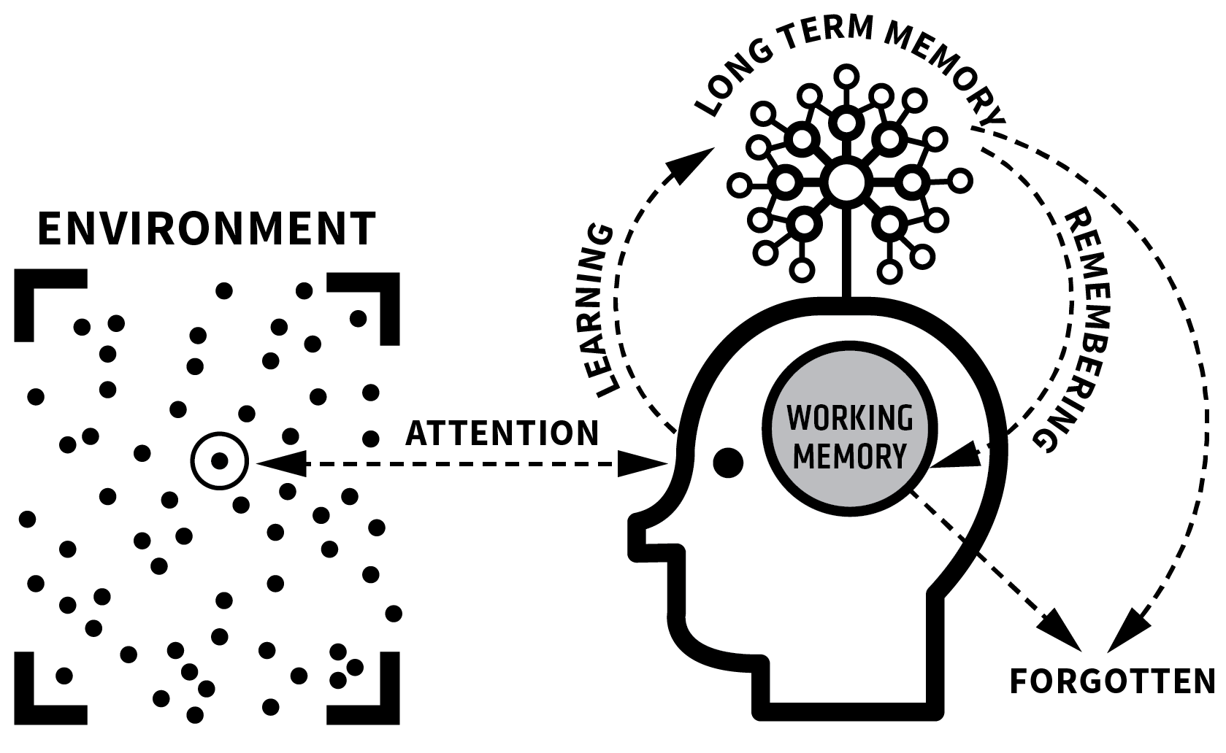
INTEGRATING THEORY & PRACTICE
1
2
3

Slide 4
INTEGRATING THEORY & PRACTICE
1
2
3
Home | social context;
life opportunities
Prior knowledge
Experience. Habits
Sense of self; motivation
School curriculum
Quality of education to date; reading
Generative Activities:
Range, depth, variety,
frequency, intensity.
Removing recency and cue
Spaced; interleaved
Big Picture, fine detail
Practice:
Fluency, automaticity
“Understanding is
remembering in disguise.”
Clarity of communication
Resources and activity design
“Memory is the residue of thought”
Nuthall’s ‘three times’ rule
Small steps
Dual Coding
Active schema-building
Knowledge builds on knowledge
Learning Environments
Study Habits
Concentration

Slide 5
So what? Key takeaways:
Think about the space in which your child/ren are revising/working in and the cognitive load
Multi-tasking is a false economy
Are they ‘cramming’? We should all be promoting ‘inter-leaving’, ‘spaced practice’, ‘chunking’, retrieval practice (little and often!)
Mental ‘hygiene’:
Plenty of sleep, early nights
Lots of water
Healthy diet
Exercise
Promote and healthy body and mind – aids with feelings of stress and overwhelm

