Slide 1


Year 7 Interim Report December 2022
A parent/carer's guide to
understanding the new
Curriculum for Wales report.
Please click for sound

Slide 2
The front cover of the report will give information with respect to your child’s attendance.
This will include:
Authorised absence
Unauthorised absence
Times late

Slide 3
Each subject will now report on your child’s progress with respect to their Attitude to Learning (AtL) and their Wellbeing.
There are 6 Areas of Learning Experience (AoLE).
In each AoLE, you will find the different subjects.
Mathematics & Numeracy
Maths
Languages, Literacy and Communication
English
Spanish
Welsh
Science & Technology
Science
Design and Technology
ICT
Expressive Arts
Music
Art
Drama
Humanities
Geography
History
Religion, Values and Ethics
Health and Well-Being
Health and Wellbeing
PE

Slide 4
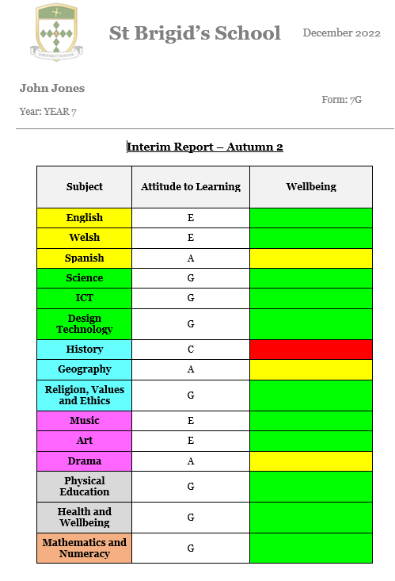
Subject Attitude to Learning and Wellbeing

Slide 5
Targets for next term (example)
Humanities
Be able to understand the difference between facts, opinions and beliefs, and consider how this may affect the importance and usefulness of evidence.
Develop the ability to reflect on the strengths and weaknesses of the approaches she has taken to her enquiries.

Slide 6
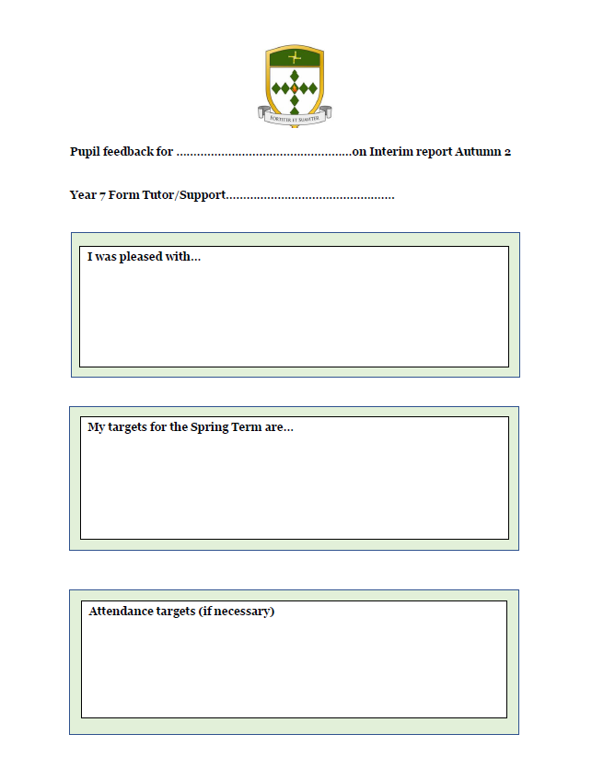
Pupil report feedback and target setting

