Slide 1
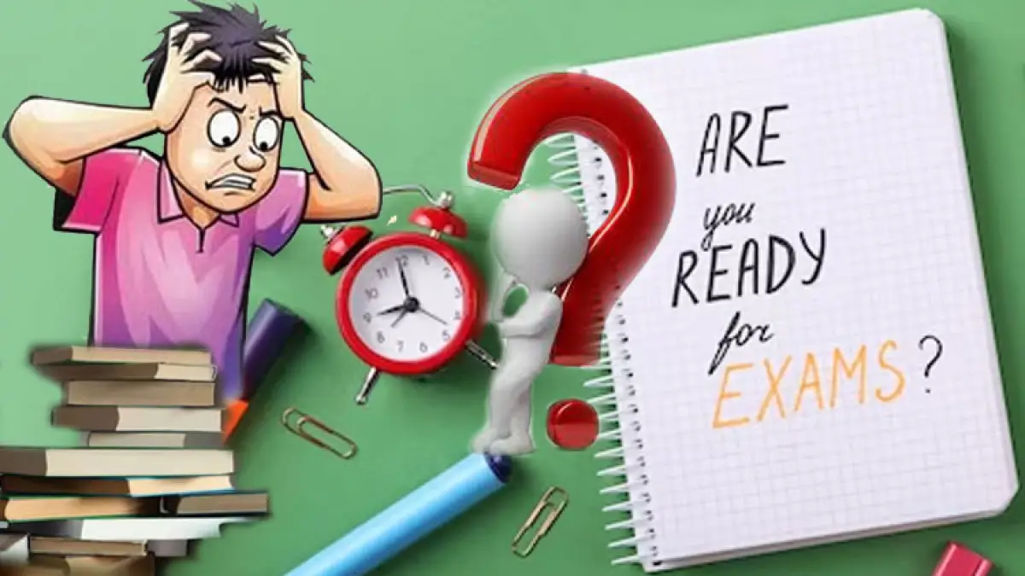

Slide 2

Revision: Timetables and planning
GCSE Bitesize
Get your revision plan right
It's a good idea to create a revision timetable to help you make the most of your time and to ensure you've scheduled time for rest and play as well as for homework and revision. Everyone's timetable will be different, but we've created an example to give you some inspiration, and a blank template that you can use as the basis of your own.

Slide 3
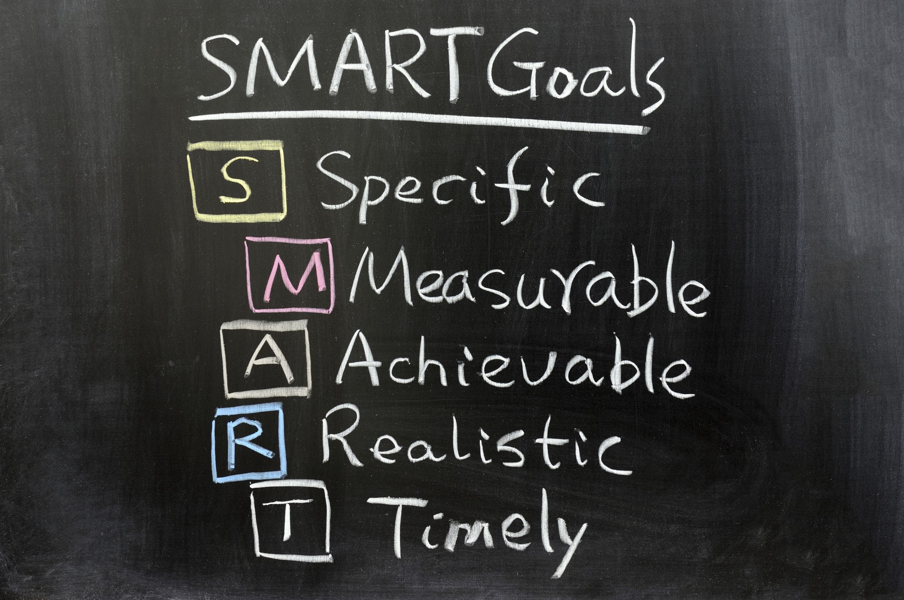
Get organised!
Find a suitable place at home to study.
Make sure you have all the equipment books /notes /pens /rulers /calculators / highlighters/post it notes etc.
Ensure that you have room to work.
Plan a schedule that is SMART

Slide 4
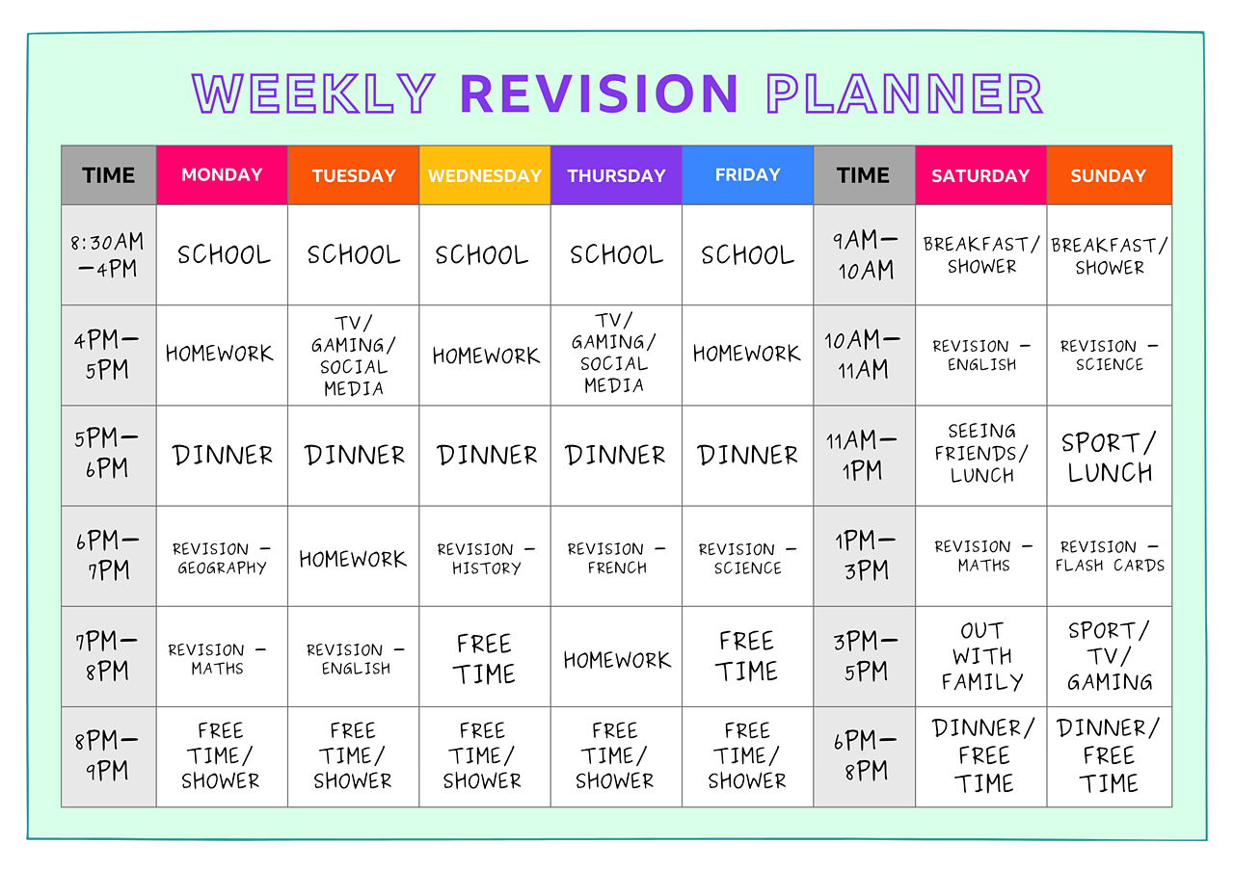

Slide 5

Everyone has a different way of learning – it is going to be important that you find a way that works for you. There is no right or wrong way – you just have to find what works best for you.
Some ideas:-
Flashcards
Flashcards are really useful when you're revising. They can help you test yourself and you can personalise them to include the things that you struggle to remember. Here's some top tips on how to create a fun and fact-filled flashcard that will work for any subject you are revising!

Slide 6
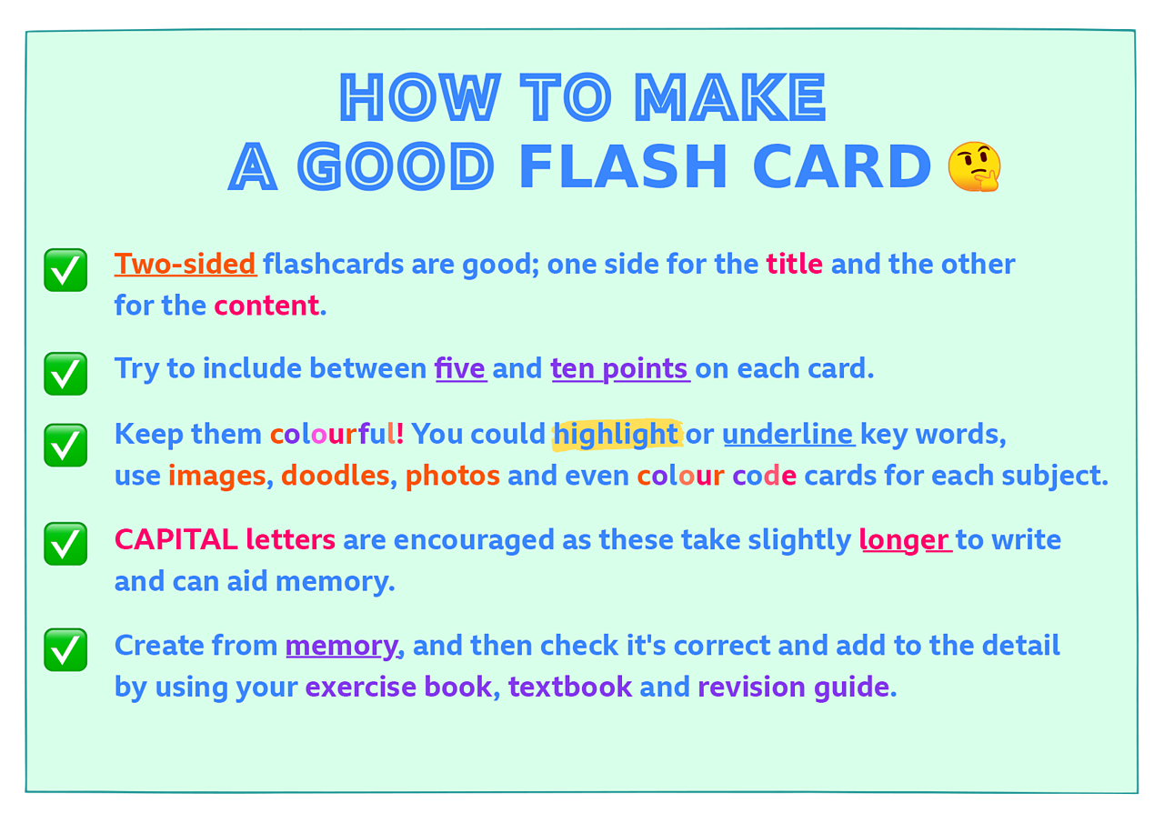
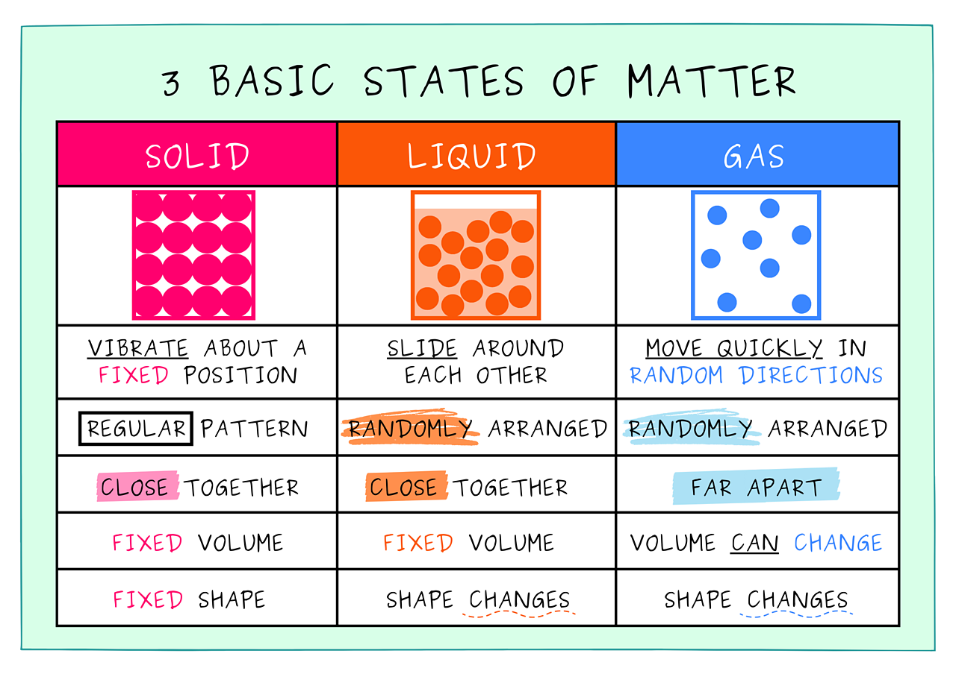

Slide 7
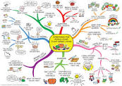
Mind Maps
Creating a mind map can really help your existing knowledge of a subject and help solidify that information in your mind. Mind mapping is a great way to plot down a lot of information on a subject to help your remember the things you need to know. Here are some useful things to remember when you create a mind map, and some mind map examples for you to check out for inspiration!

Slide 8
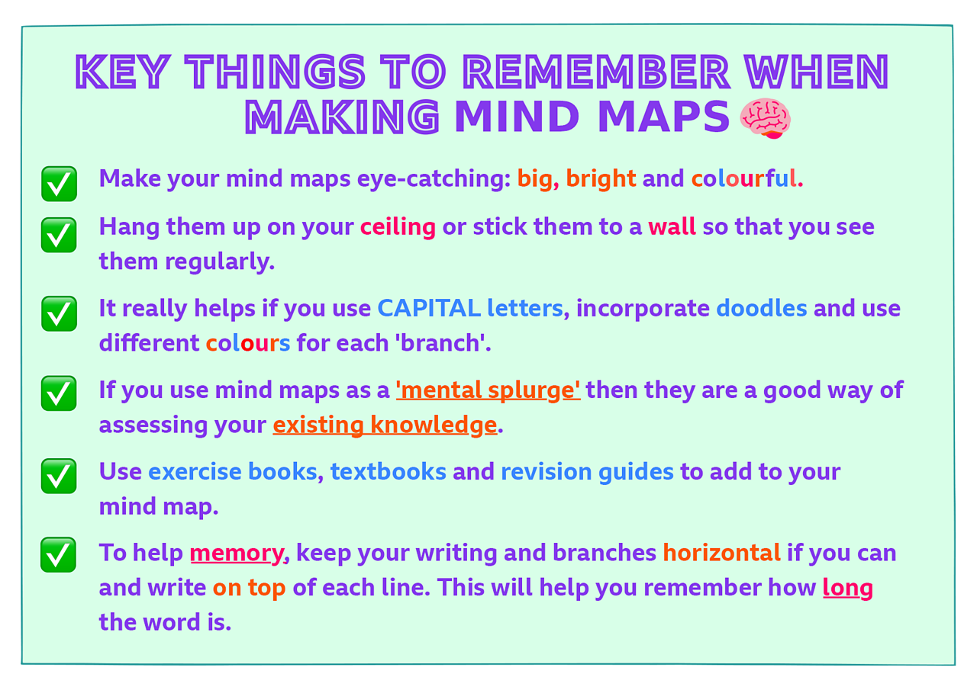
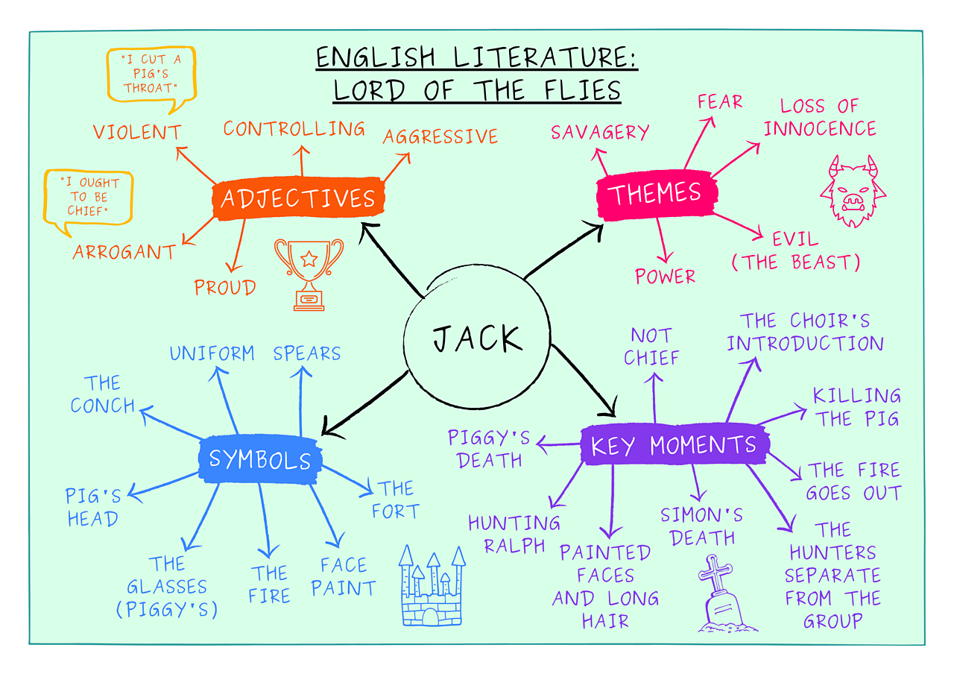

Slide 9
Re- writing notes
Going through the work – highlighting key points and re writing these can be helpful for some people.
Recording & listening
Record yourself reading out key points and listening to these recordings
Past paper work
Do as many past papers as you possibly can – nothing will then be a surprise in the examination
Test yourself
Write questions on topic areas – make sure you are familiar with the answers and test yourself or get a parent/friend to test you

Slide 10
https://www.bbc.co.uk/bitesize/articles/zn3497h
https://www.bbc.co.uk/bitesize/articles/z6pv3k7#zgcq2v41

