Slide 1
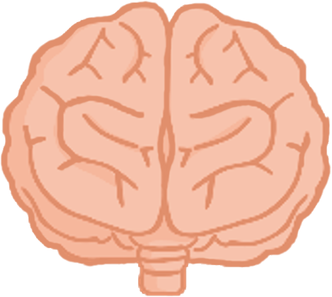
How do you revise?
Revision

Slide 2
Revision Techniques
Active
Passive
(Makes the brain work)
(doesn’t fully engage the brain)
answer practice questions
past papers
repetition
test your friends
reading notes
copying notes
flashcards
teach someone else
educational videos
discussion
mind maps
draw diagrams / tables

Slide 3
Revision Techniques
Active
Passive
(Makes the brain work)
(doesn’t fully engage the brain)
answer practice questions
discussion
draw diagrams / tables
educational videos
flashcards
copying notes
mind maps
reading notes
past papers
repetition
teach someone else
test your friends

Slide 4
Active Techniques
Active
activates the memory centres of your brain
makes you re-assess the information you think you know
far more interesting than passive revision exercises

Slide 5
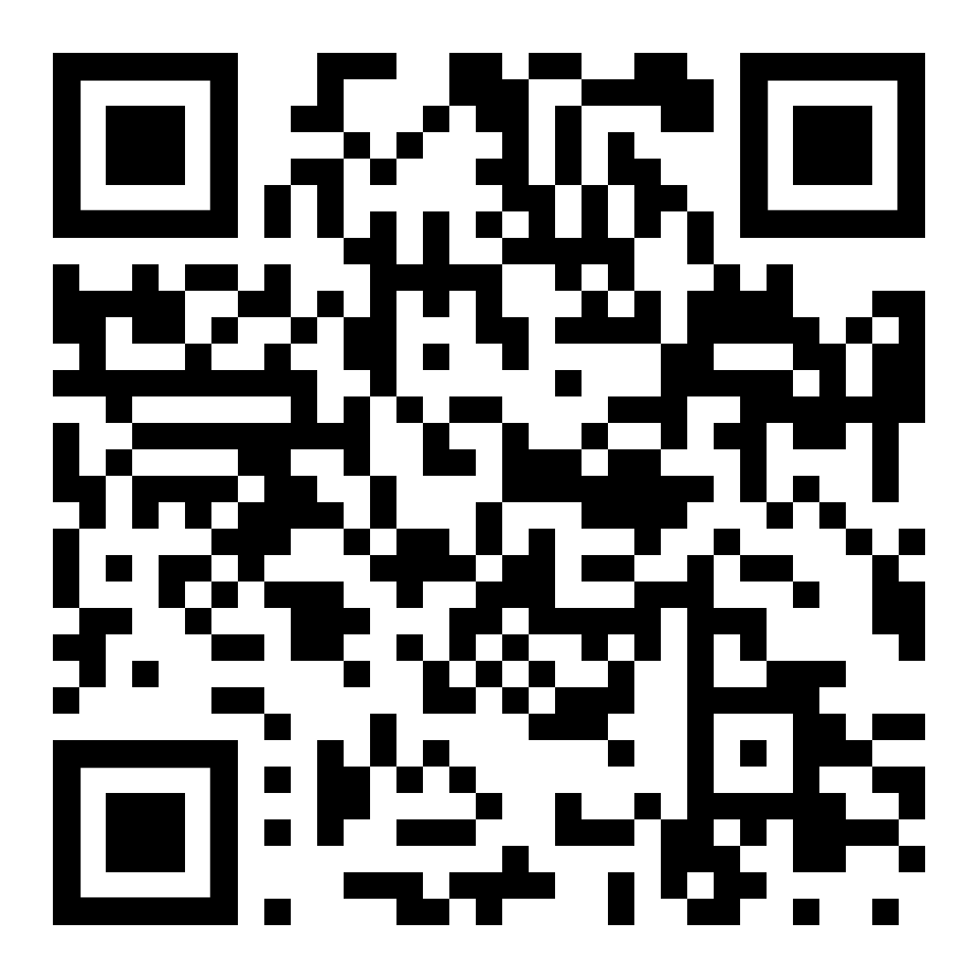
How much revision time?
Notes:
https://www.youtube.com/watch?v=4jfoxD3n-Dk
Last checked 15-Sep-2022

Slide 6
How much revision time?
School day
Holidays & weekends
6 hours
1-2 hours

Slide 7
Which is best?
Q
Revise multiple subjects across the day
or
Revise one subject across the day

Slide 8
Which is best?
A
✓
Revise multiple subjects across the day
or
Revise one subject across the day

Slide 9
If only one subject
to study
Topic 1
Topic 2
Topic 3
Topic 4
break it
down into
different topics throughout the day
Topic 5
Topic 6
Topic 7

Slide 10
Chunking
to study
Topic 1
groups of threes
Topic 2
colours
Topic 3
fonts
Topic 4
If it is a
particularly key
idea, consider using a mnemonic to memorise the order of it
Topic 5
Topic 6
Topic 7
eg. (Richard Of York Gave Battle In Vain)

Slide 11
Organisation
1
find out exam dates
2
prioritise subjects
3
plan your revision timetable
4
plan one week at a time

Slide 12
Plan
“Good exam results are made in the Easter holidays. Now is the time to start planning effective methods for learning all that work you have done in the past two or more years.”
Professor Barnaby Lenon
University of Buckingham
former Schoolmaster Harrow

Slide 13
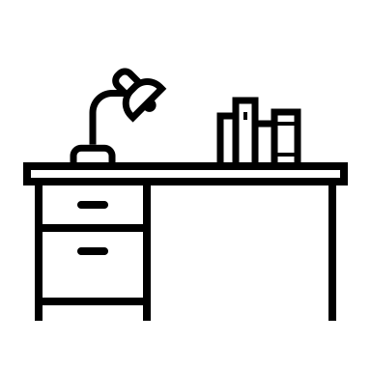
Create your Study Zone
Quiet
Well-lit
Spacious

Slide 14
Avoid Distractions
Don’t lose your flow…
Focus!

Slide 15
The Pomodoro Technique
1
25 min work session
5 min break
2
25 min work session
5 min break
3
25 min work session
5 min break
4
25 min work session
25 min break

Slide 16
During your break
Chat
Doodle
Sport
Play
Play
Walk
Exercise Video
Not too long!

Slide 17
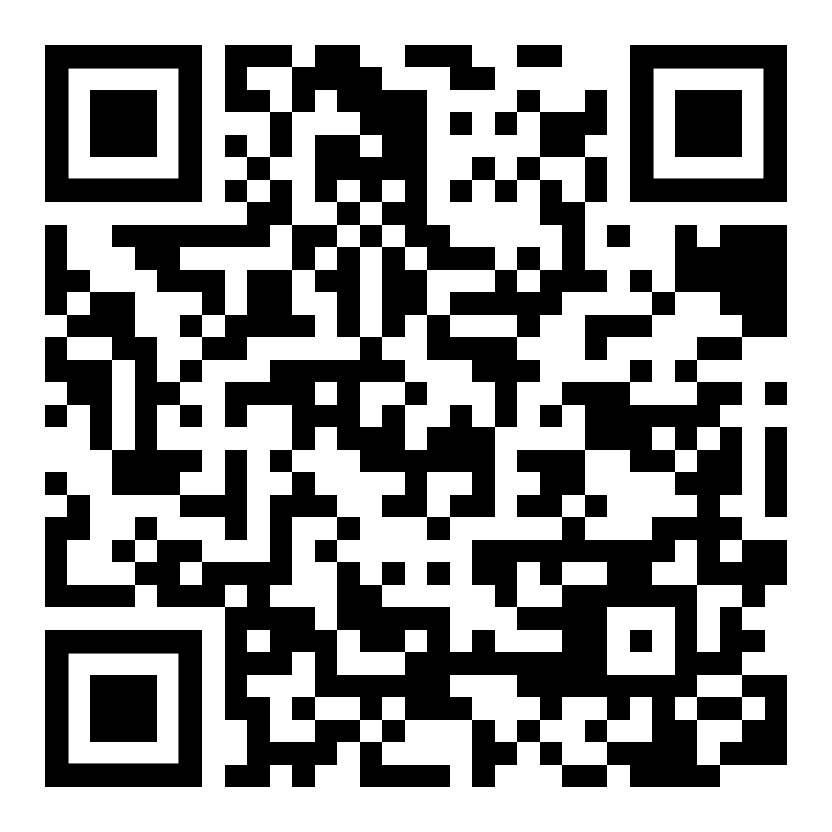
Repetition is key
repeat, repeat, repeat
Notes:
https://www.youtube.com/watch?v=cVf38y07cfk
Last checked 15-Sep-2022

Slide 18
Testing for learning
testing yourself is the most important aspect of your revision

Slide 19
Keep your body healthy
sleep
exercise properly
eat healthily
A healthy body = a healthy mind

Slide 20
Further reading
https://www.lovelearningtutors.com/main-blog/how-to-revise

